Slide 1
Music Transformation with AI

Slide 2


Project Summary

Slide 3
Problem
Importance
Automating this process has the potential to revolutionize music production by:
Streamlining workflows.
Reducing production costs.
Unlocking new creative possibilities.
It also provides valuable tools for music education by enabling learners to analyze and create music more effectively.
The traditional process of separating and transcribing music from audio recordings is time-intensive and demands specialized expertise.
This creates accessibility barriers for many musicians and producers, limiting creative exploration and efficiency.
Notes:
Problem:
The current process of separating and transcribing music from audio recordings is time-consuming and often requires specialized skills.
This limits accessibility for many musicians and music producers.
Importance:
Automating this process can revolutionize music production by streamlining the workflow, reducing costs, and enabling new creative possibilities.
It can also benefit music education by providing a tool for learning and analysis.
Goals:
Audio Separation: Develop a model to accurately separate vocals and instruments from a given audio track.
Instrument Identification and Transcription: Identify individual instruments within the separated tracks and convert their audio into musical notation.
Vocal Transcription: Transcribe the vocals into text format, providing a synchronized lyric and music experience.
By achieving these goals, we aim to create an AI-powered tool that empowers musicians and music enthusiasts to work more efficiently and creatively.

Slide 4
Vision
Goals
Audio Separation Develop or use an AI model to isolate vocals and instruments from audio tracks with high accuracy.
Instrument Identification and Transcription Convert separated instrument tracks into MIDI format for musical notation and perform further modification to MIDI.
Vocal Transcription Extract lyrics from vocals and align them with the music for a synchronized audio-lyric experience.
By achieving these goals, the AI-powered tool will empower musicians and producers to work more creatively and efficiently, transforming how music is created, learned, and experienced.
Notes:
Problem:
The current process of separating and transcribing music from audio recordings is time-consuming and often requires specialized skills.
This limits accessibility for many musicians and music producers.
Importance:
Automating this process can revolutionize music production by streamlining the workflow, reducing costs, and enabling new creative possibilities.
It can also benefit music education by providing a tool for learning and analysis.
Goals:
Audio Separation: Develop a model to accurately separate vocals and instruments from a given audio track.
Instrument Identification and Transcription: Identify individual instruments within the separated tracks and convert their audio into musical notation.
Vocal Transcription: Transcribe the vocals into text format, providing a synchronized lyric and music experience.
By achieving these goals, we aim to create an AI-powered tool that empowers musicians and music enthusiasts to work more efficiently and creatively.

Slide 5

Approach

Slide 6
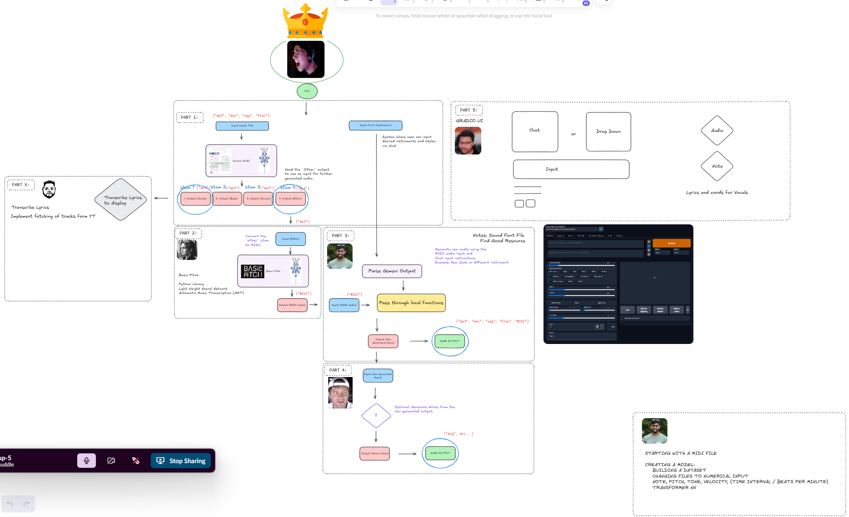
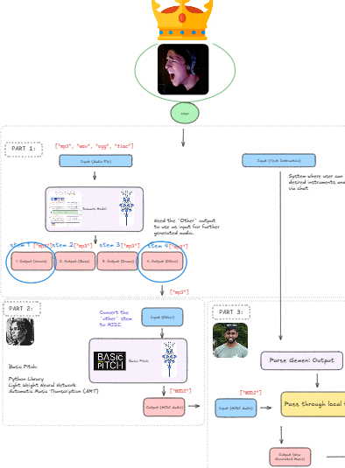
Concept pathway…
Excalidraw Concept Graph: Link
Created visual concept of how our idea may (or may not) come to fruition. To start taking steps as a team to reach the plan.
Transform the MIDI file into something new by applying text-based prompts and additional processing (Using Gemini or other AI models)
Use a model (demucus) to separate the audio tracks into “stems” (vocals, drums, bass, and instrumental)
Visualize and refine the MIDI into musical notation for practical use in music production.
Extract the instrumental stem and convert it into MIDI using another model (basic pitch)
Why MIDI? MIDI is a widely recognized format in music production, enabling easy modification and integration.

Slide 7

Data Exploration

Slide 8

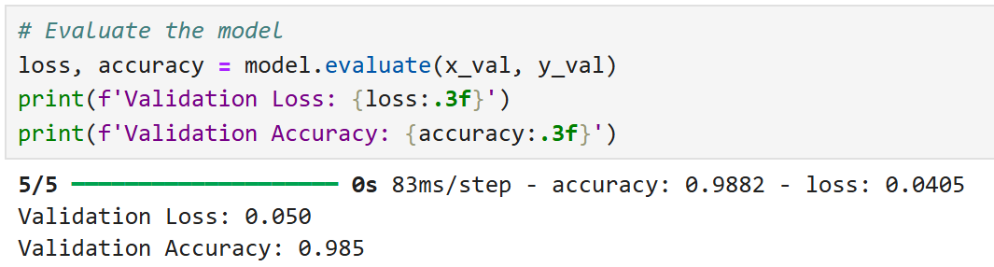
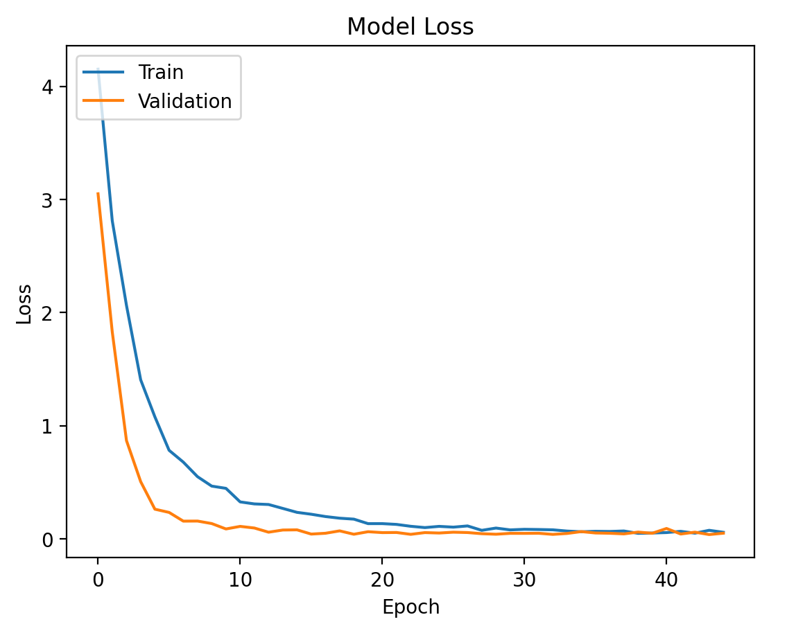
requirements:
CNN Model
An overview of the data collection, cleanup, and exploration processes. Include a description of how you evaluated the trained model(s) using testing data. (5 points)
Data Collection was difficult with

Slide 9
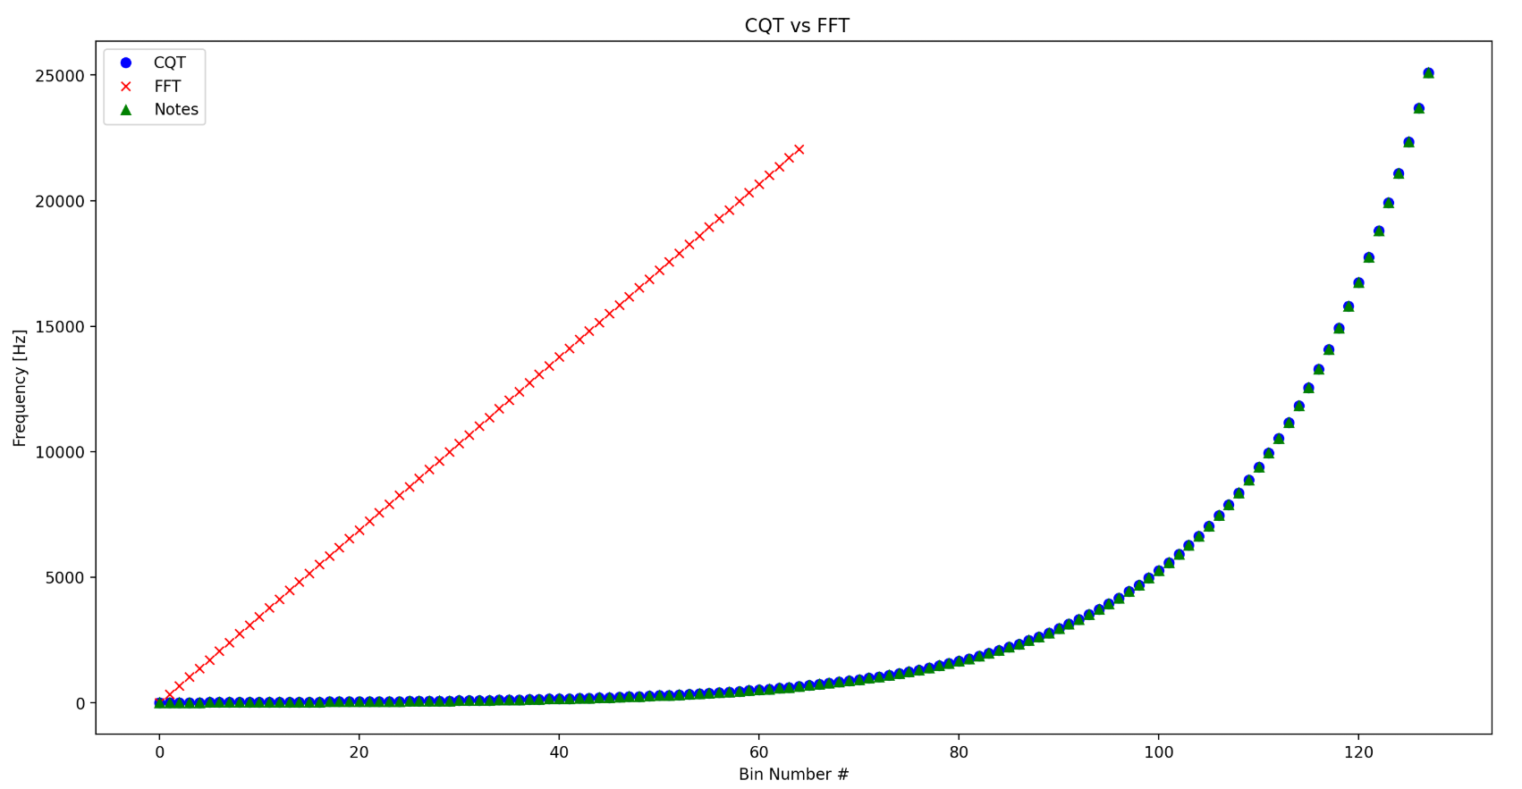
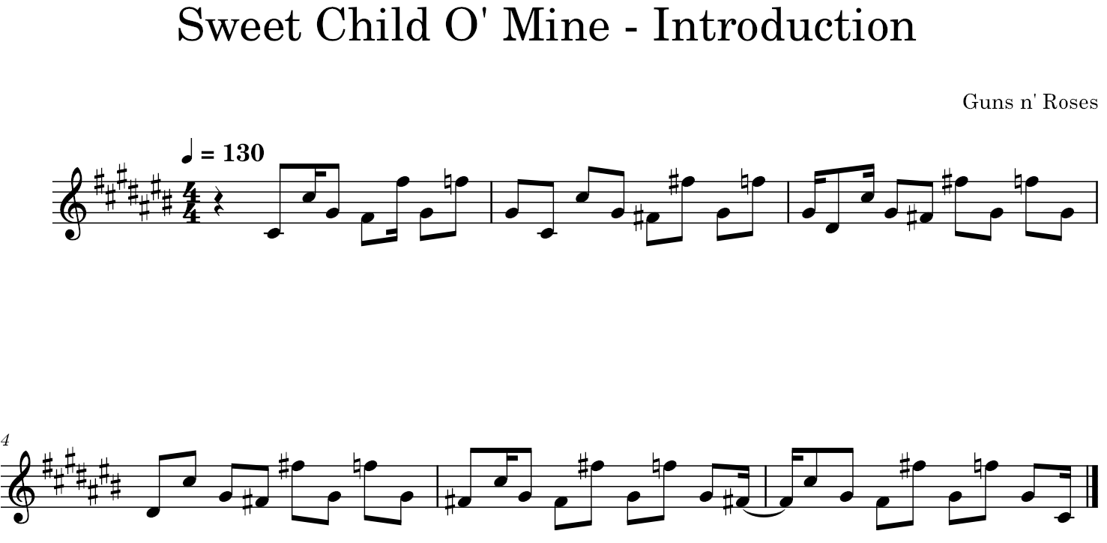
requirements:
CNN Model
An overview of the data collection, cleanup, and exploration processes. Include a description of how you evaluated the trained model(s) using testing data. (5 points)
You must use one additional library or technology NOT covered in class, such as:
Valence Aware Dictionary for Sentiment Reasoning (VADER)
Whisper (OpenAI’s automatic speech recognition system)
DALL·E (OpenAI’s text-to-image model)
Other OpenAI capabilities, including:
Text-to-speech
GPT-4 with vision (GPT-4V)
PyTorch

Slide 10

Challenges

Slide 11

Challenges
Steep leaning curve with MIDI and musical composition
Acquiring datasets with labeled music were extremely limited and difficult to find
Limited access to pretrained models as this is an underserved area AI
Notes:
Steep leaning curve with MIDI and musical composition
Acquiring datasets with labeled music were extremely limited and difficult to find
Limited access to pretrained models as this is an underserved area AI

Slide 12

Project Demonstration

Slide 13
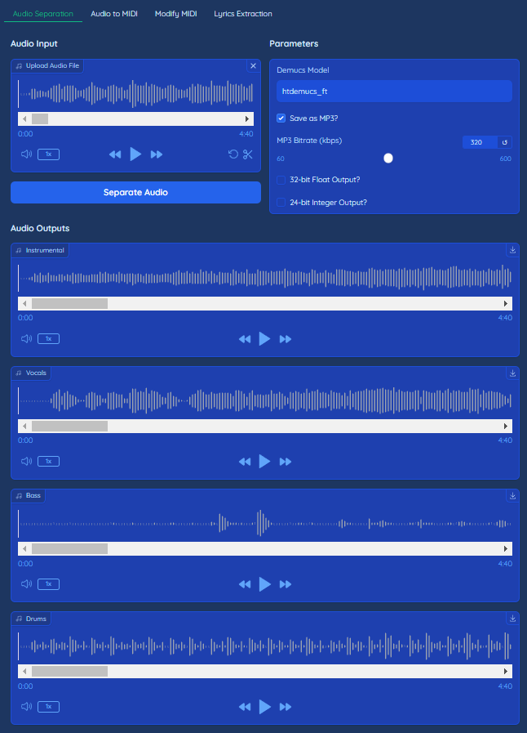
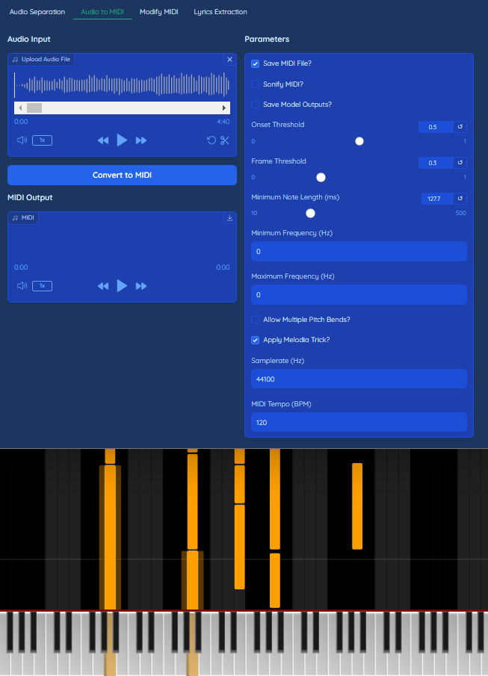
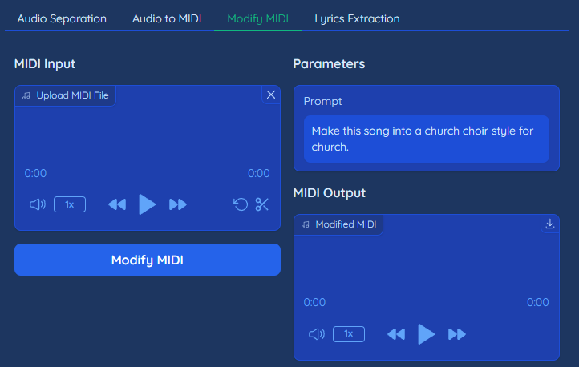
App Details
Separate Audio Stems: Separates bass, drums, voice, and instrumental from audio.
Audio to MIDI: Converts audio to MIDI file.
Modify MIDI: Modifies the MIDI file changing the audio to other styles, scales, etc.
Lyrics Extraction: Extract lyrics from audio that contains vocals.

Slide 14

DEMO

Slide 15

Future Goals

Slide 16
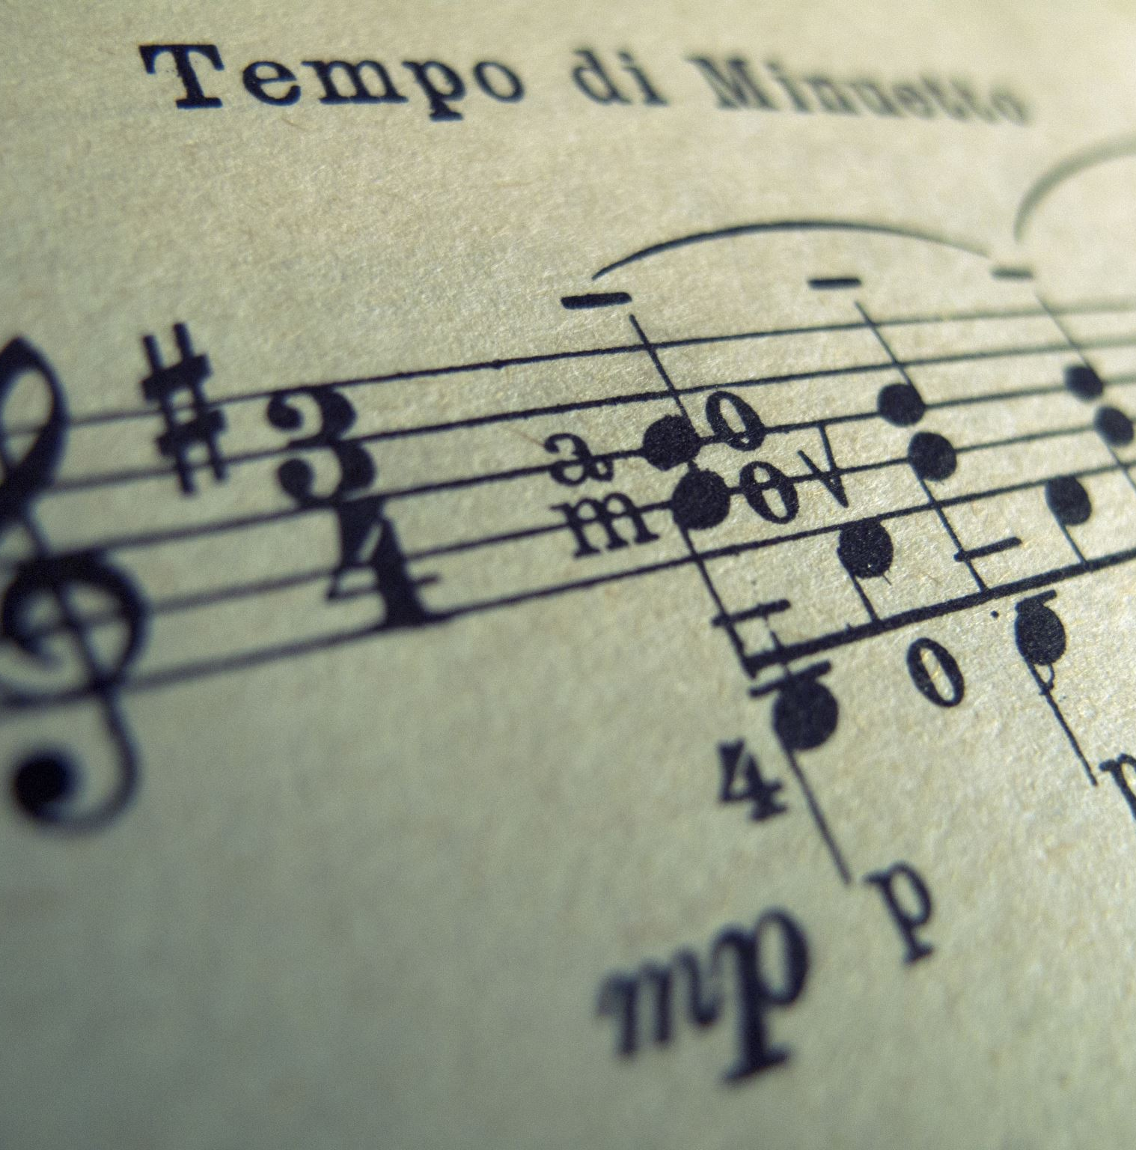
Future Goals:
Enhanced Audio Processing
Improve Instrument Separation: Develop advanced models for isolating multiple instruments more effectively within a given song.
Expand Training Data: Acquire diverse and well-labeled datasets for individual instruments to improve model training and accuracy for Audio to MIDI conversion, MIDI to Sheet Music, And MIDI w/ Text to MIDI conversion.
Improved Sheet Music Accuracy
Refine MIDI Conversion: Address inaccuracies in MIDI translations caused by overlapping instrument tracks and notes.
Optimize Outputs: Develop methods to clean and simplify MIDI files, ensuring a single, coherent output for better sheet music generation.
Notes:
Audio Processing
Develop models that are better at separating multiple instruments within a given song.
Acquire more labeled datasets for individual instrument to better train models on.
Sheet Music
Currently most notes are converted using midi files, but are very inaccurate due to overlapping instruments and notes within the midi files.
If given more time we would work on cleaning the midi files to a single output for better translation

Slide 17

Results

Slide 18
Working Tools
✅ Obtain output stems (vocals, instrumental, bass, drums) from selected audio file.
✅ Convert audio to MIDI format.
✅ Modify MIDI using a Prompt and MIDI as an input.
✅ Extract Lyrics from Vocals audio.

